Slide 1
COM1025: Web and
Database Systems
Module Introduction, Web, URL HTML, JavaScript
(Slides credited to Dr. Manos Panaousis)
Joe Appleton
Week 7

Slide 2
A Question To Start
Why is this course teaching both Databases and Web ?

Slide 3
A Question To Start
Why is this course teaching both Databases and Web ?
  Almost everyone will interact with Databases everyday, several times a day
  Very few people know how to write SQL Queries
  We need to provide some interface over the database to allow the right data to be extracted without the need to know SQL
  Web applications are one of the most commonly used ways to interact with data in a Database

Slide 4
Structure for Weeks 7 - 10
 | LECTURES
WEEK 7 | An Internet Primer
WEEK 8 | Networking , HTML forms , HTTP, COOKIES Styles, Templating, Forms, GDPR, Routing
WEEK 9 | Tying everything together - The three-tier architecture
WEEK 10 | Advanced database concepts

Slide 5

A quick question:
PollEv.com/joeappleton531

Slide 6
Introduction

Slide 7
Today’s outline
About me
Module learning outcomes
Module general information
Module content
Introduction to internet systems
  Web, URL
Front-end
  HTML
  Encoding

Slide 8
About Me
10-years start up and industry experience.
8-years' experience as an academic
Research interests are software engineering in the context of learning in HE.

Slide 9
Learning outcomes for this Section
On successful completion of this module, you will be able to:
  Understand how the World Wide Web works and how it relates to the wider context of the Internet.
  Understand basic concepts of computer networking.
  Demonstrate an understanding of key Web front-end (publishing) technologies and their relationships: HTML, CSS,Node.js, XML, JSON.
    Build static and simple dynamic web pages.

Slide 10





Some of the technologies we’ll be using
Client
C
Server

Slide 11
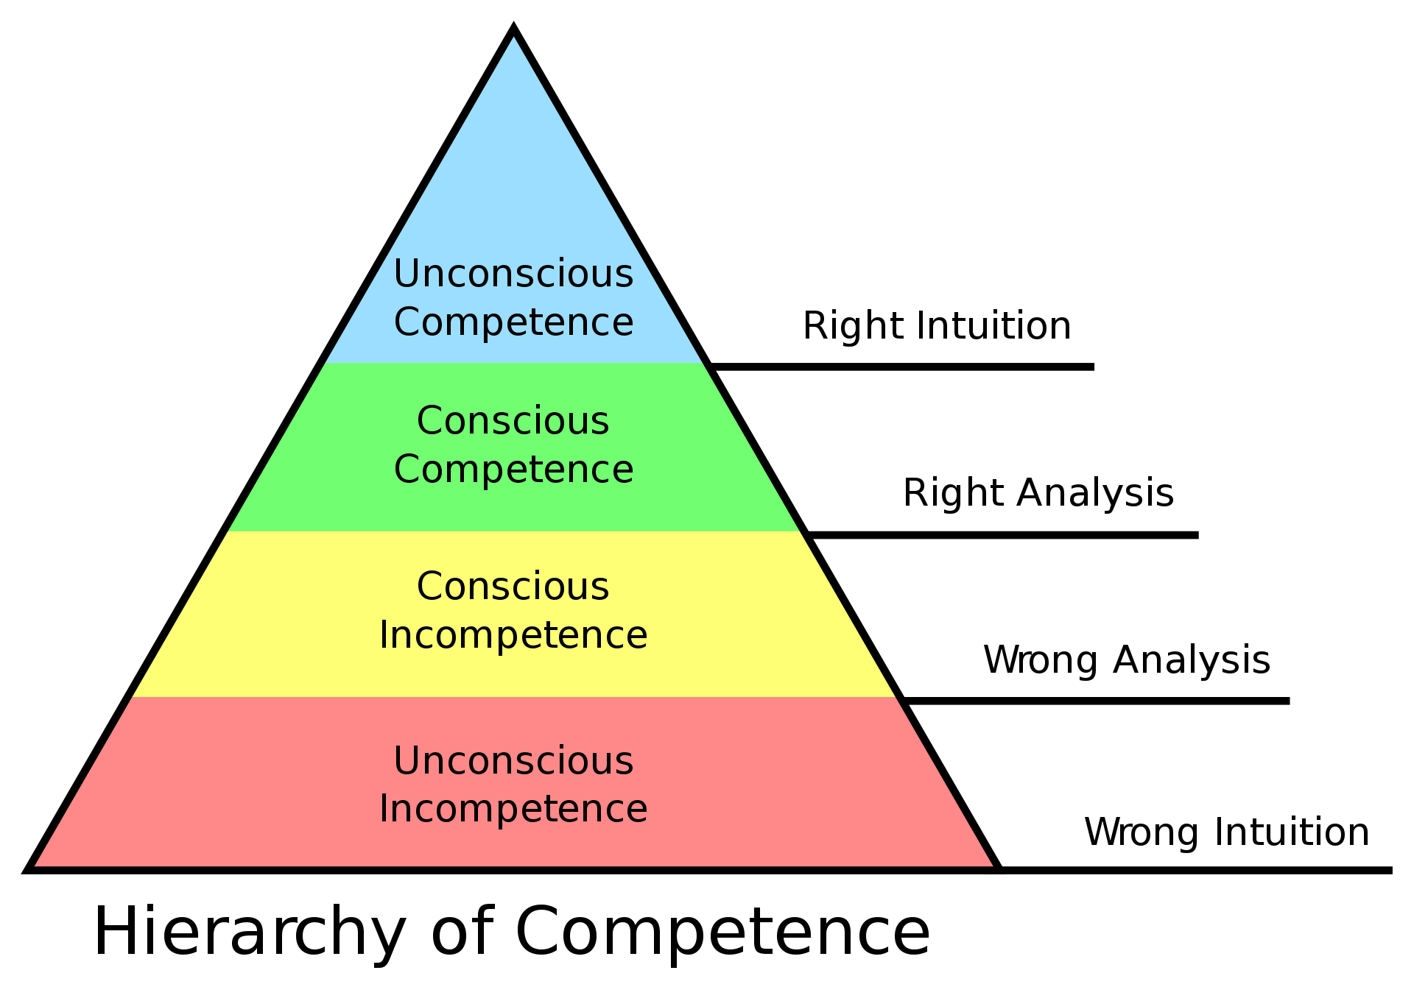
Where are we aiming?

Slide 12
Module follow-ups
COM1025 was designed to be an entry-level module
  Cover many topics
    JavaScript, CSS
  More advanced materials are available for year-2 and/or year-3
COM2025 Web Application Development
  …
  JavaScript (jQuery)
  CSS (LESS)
  …
COM3014 Advanced Challenges in Web Technologies
  …
  Rich Client Web Applications
    JavaScript
  …

Slide 13
The World Wide Web

Slide 14



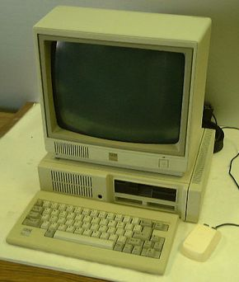
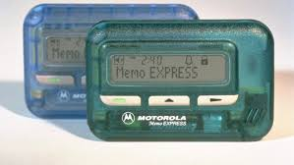
A Trip to the 80s

Slide 15

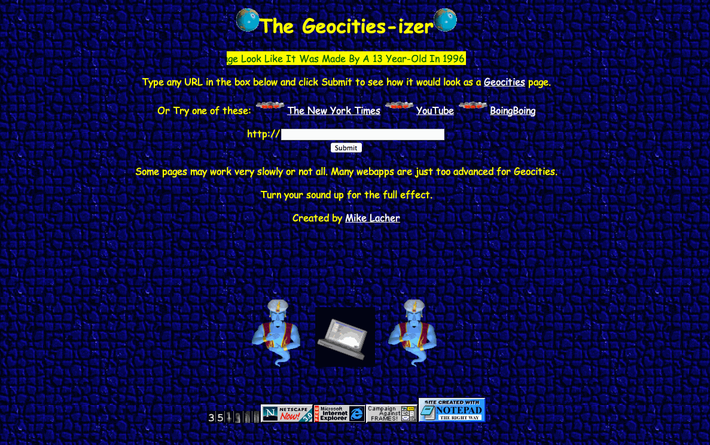
An early timeline of the web
1989: Tim Berners-Lee proposed a hypertext system that would sit on top of the internet.
The system consisted of of the following primary technologies:
                A Universal Resource Locator (URL) to identify resources
                Hyper Text Markup Language (HTML) to represent HTML documents
                A Hyper Text server implementing HTTP
                1993: The proposal of an IMG tag and the Mosaic Browser
                1994: Yahoo! is created by Stanford University Graduates
                GeoCities Created
                1995: Amazon and Ebay are created
Notes:
CERN is a wonderful organisation. It involves several thousand people, many of them very creative, all working toward common goals. Although they are nominally organised into a hierarchical management structure,this does not constrain the way people will communicate, and share information, equipment and software across groups.
The actual observed working structure of the organisation is a multiply connected "web" whose interconnections evolve with time. In this environment, a new person arriving, or someone taking on a new task, is normally given a few hints as to who would be useful people to talk to. Information about what facilities exist and how to find out about them travels in the corridor gossip and occasional newsletters, and the details about what is required to be done spread in a similar way. All things considered, the result is remarkably successful, despite occasional misunderstandings and duplicated effort.

Slide 16


What is HTML?
HTML (HyperText Markup Language)
  Describes the content and structure of a web page; not a programming language.
  Made up of building blocks called elements.
  HTML was invented, in 1989, by Tim Berners- Lee (Prof Univ. of Oxford)
  Standards are maintained and developed by the World Wide Web Consortium (W3C).
Notes:
CERN is a wonderful organisation. It involves several thousand people, many of them very creative, all working toward common goals. Although they are nominally organised into a hierarchical management structure,this does not constrain the way people will communicate, and share information, equipment and software across groups.
The actual observed working structure of the organisation is a multiply connected "web" whose interconnections evolve with time. In this environment, a new person arriving, or someone taking on a new task, is normally given a few hints as to who would be useful people to talk to. Information about what facilities exist and how to find out about them travels in the corridor gossip and occasional newsletters, and the details about what is required to be done spread in a similar way. All things considered, the result is remarkably successful, despite occasional misunderstandings and duplicated effort.

Slide 17



Client Server
Local
Remote
Client
Server
Client
DB
…..
Client

Slide 18
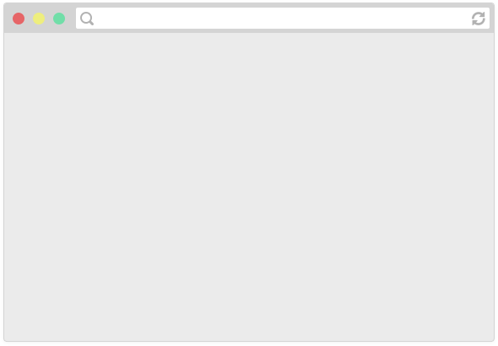
How do web pages work?
Browsers are applications that can display web pages,
e.g. Chrome, Firefox, Safari, Internet Explorer, Edge, etc.

Slide 19
Hypertext documents
Hypertext documents are more commonly known as web pages.
Hypertext documents may link to hypermedia documents, i.e., non-hypertext documents (e.g. an image, a video, a textual file without any special structure).
A web page or a hypermedia document normally resides on a remote computer (called a web server) over the Internet so they can be accessed by people from anywhere in the world.
  Each web page or hypermedia document has a web address, or more formally a URL (Uniform Resource Locator) which mainly tells where it is.

Slide 20

How do web pages work?
Web pages are written in a markup language called HTML
Browsers display a web page by reading and interpreting its HTML

Slide 21
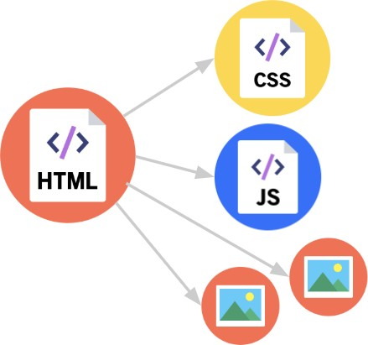
How do web pages work?
The HTML file may link to other resources, like images, videos, as well as JavaScript and CSS (stylesheet) files, which the browser then also loads.

Slide 22
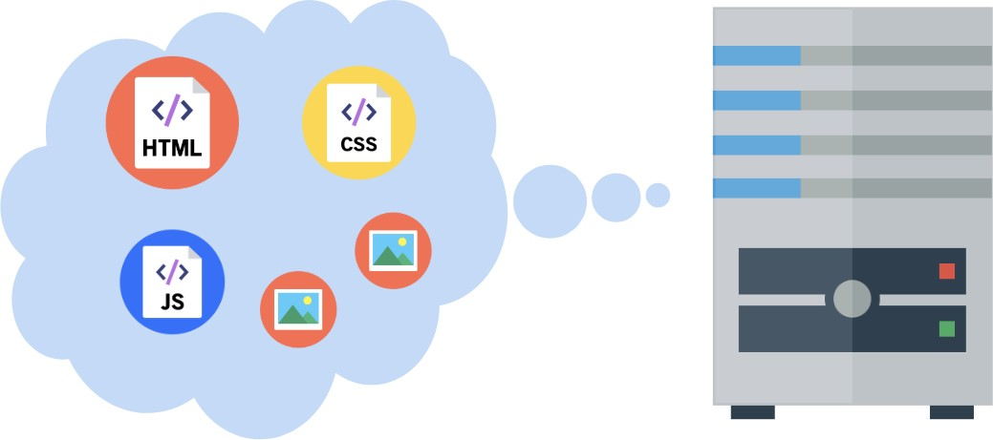
How do web pages work?
A web server is a program running on a computer that delivers web pages in response to requests.
It either has stored or generates the web page returned.

Slide 23
How do web pages work?
1. You type in a URL, which is the address of the HTML file on
the internet.
www.surrey.ac.uk

Slide 24
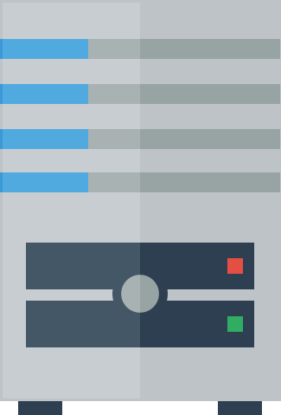
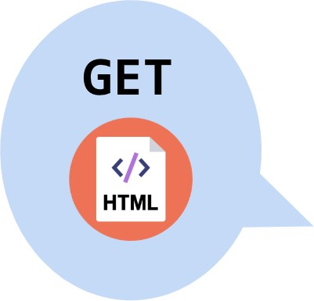
How do web pages work?
2. The browser asks the web server that hosts the document to send that HTML document.

Slide 25
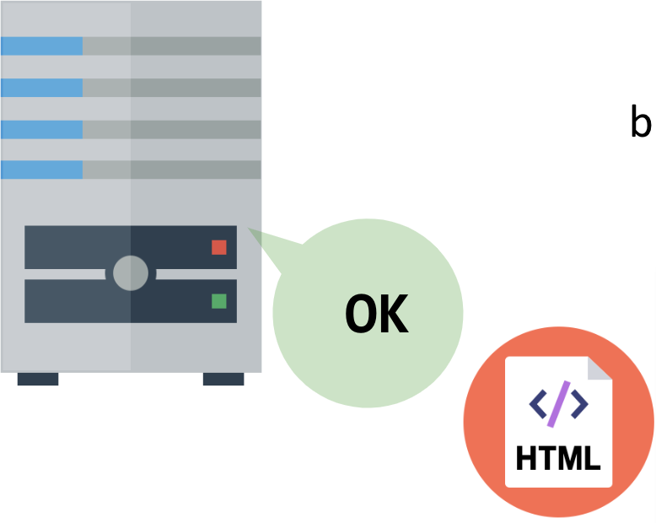
3. The web server responds to the browser with the HTML file that was requested.

Slide 26
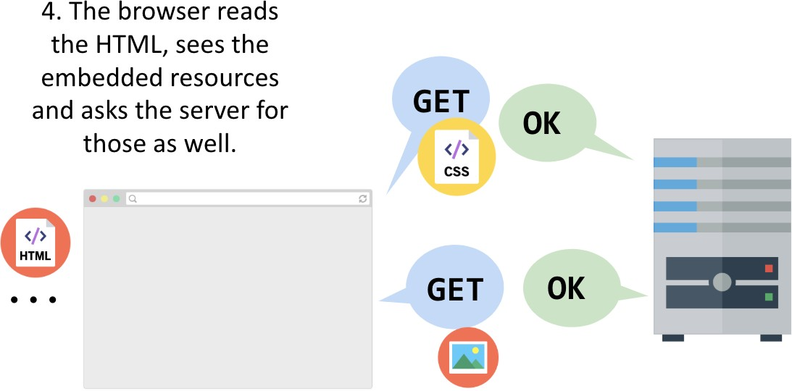
How do web pages work?

Slide 27


How do web pages work?
5. The web page is loaded when all the resources are fetched and displayed.
www.surrey.ac.uk

Slide 28

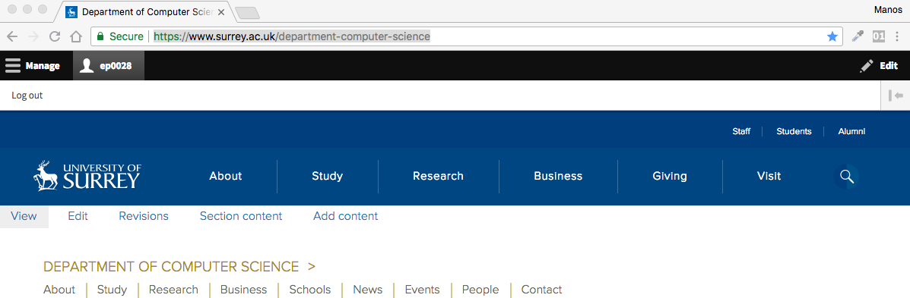
Request – response in more detail
Your PC is running a web browser

Slide 29
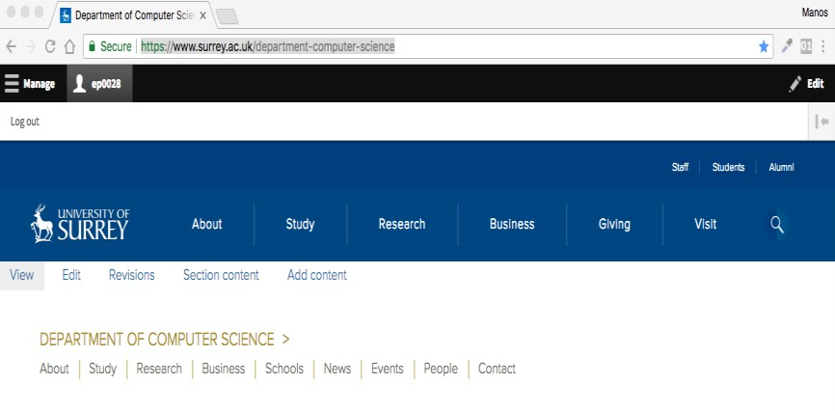
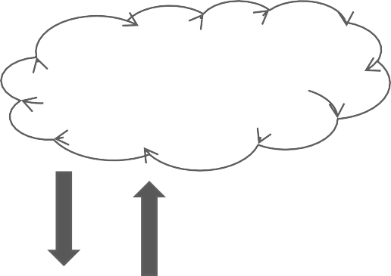


Web browser
Browser sends an HTTP request saying "Please GET
me the index.html file” at “https://www.surrey.ac.uk/”
Networking etc.
Assuming all goes well, the server responds by sending the HTML file through the internet back to the browser to display.
Server at https://www.surrey.ac.uk/

Slide 30
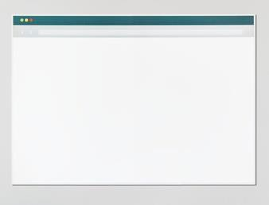
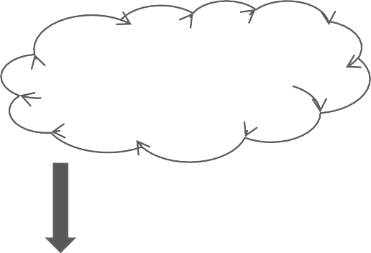
Web browser
The HTML will include things like <img src="pup.png" /> and <link src="style.css" .../> which generate more requests for those resources
Networking etc.
Server at https://www.surrey.ac.uk/
Web and Database Systems (COM1025)

Slide 31
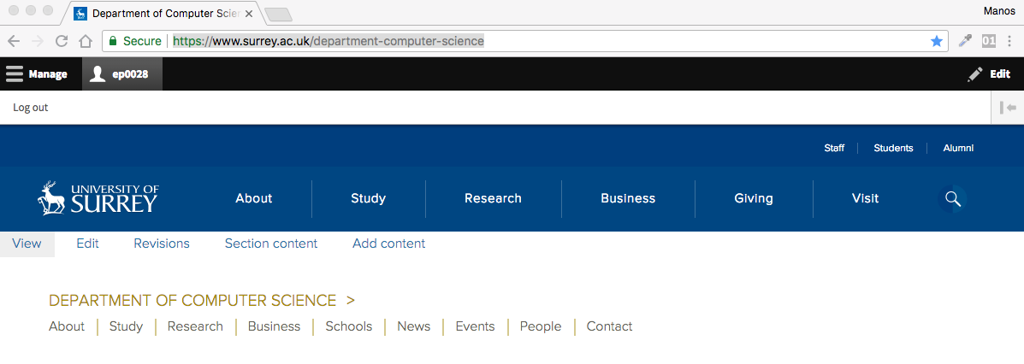
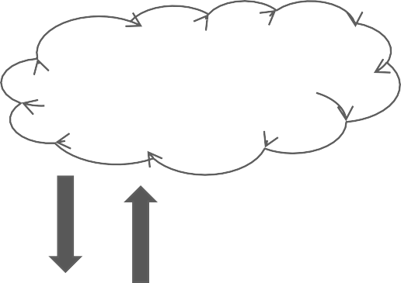
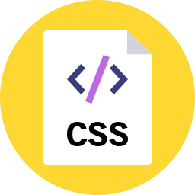

Web browser
Networking etc.
And the server replies with those resources for the browser to render
Server at https://www.surrey.ac.uk/
Web and Database Systems (COM1025)

Slide 32
Web browser
+
produces
Describes the content and structure of the page
Describes the appearance and style of the page
A web page… that doesn't do anything

Slide 33
URL

Slide 34
URI
A Uniform Resource Identifier (URI) is a string of characters used to identify a resource
The most common form of URI is the Uniform Resource Locator (URL), frequently referred to informally as a web address, e.g. https://developer.mozilla.org/en-US/
  Web browsers request pages from web servers by using a URL
Some URIs refer to a location within a resource.
  This kind of URI ends with "#" followed by an anchor identifier (called the fragment identifier) – see next.

Slide 35
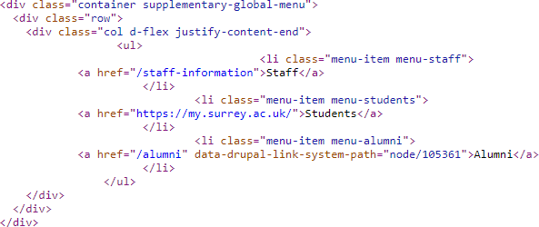
Absolute vs Relative
You can use both absolute and relative URLs.
  Absolute URL: https://www.surrey.ac.uk
  Relative URL: about is relative to https://www.surrey.ac.uk/about
Why does this matter?

Slide 36
URL syntax (as defined in RFC 3986)
Full syntax
  scheme:[//[[userinfo@]host[:port]]] [path][?query][#fragment]
scheme (mandatory for absolute URLs)
  The approach (communications protocol, “protocol” for short
hereinafter) for retrieving the document.
    http: documents retrieved via a protocol called HTTP.
    https: documents retrieved via a protocol called HTTPS.
    file: documents accessible from the local machine.
    ftp: documents retrieved via a protocol called FTP.
    mailto: documents to be sent to the given email address (emails).
…
URLs are not only for the Web!

Slide 37
URL syntax (as defined in RFC 3986)
authority
Full syntax
  scheme:[//[[userinfo@]host[:port]]] [path][?query][#fragment]
Two slashes (//): When the authority component is absent, the path component cannot begin with two slashes.
authority
  A naming authority for parsing parts of the URL.
  userinfo (optional)
    An optional authentication section of a user name and password, separated by a colon, followed by @
    The passing of authentication information in clear text has proven to be
a security risk in almost every case where it has been used.

Slide 38
URL syntax (as defined in RFC 3986)
authority
  host (mandatory)
    Domain name (or IP address) of the web site (server).
  port (optional)
    Port number used by the scheme (protocol).
      In programming, it may specify a particular server program on a computer in a network

Slide 39
URL syntax (as defined in RFC 3986)
Full syntax
  scheme:[//[[userinfo@]host[:port]]][path][?query][#fragment]
path
All the rest three components are optional.
Location of the document on the hosting machine (using “/” as the path separator).
query
also called a query string
A list of data sent to the web server, in the format
“name_1=value_1&…&name_n=value_n”.
Typical URL containing a query string is as follows:
http://example.com/over/there?name=ferret
When a server receives a request for such a page, it may run a program, passing the query string, which in this case is, name=ferret unchanged, to the program.
The first question mark is used as a separator, and it is not part of the query string.
fragment
  ID of a fragment (section/part) of the document (”pointer to an HTML element”).
  http://www.example.org/foo.html#bar the fragment refers to the element with id="bar".

Slide 40
JavaScript

Slide 41
Defining Some Terms
JavaScript: JavaScript is a programming language primarily used for creating interactive and dynamic content within web browsers. You won’t be required to write JavaScript that runs in the web browser, for this module.
Node.js: : Node.js is not a programming language but a runtime environment that allows you to run JavaScript code on the server. This is the environment we will be using for this module

Slide 42
Where Does Node.JS Run
Client
Server/Desktop
runs on a server or desktop computer
Mobile Browser
NodeJS
It can handle HTTP requests and responses
                making it well-suited for building web applications
Web Browser
Application

Slide 43

Who Uses Node.JS?

Slide 44
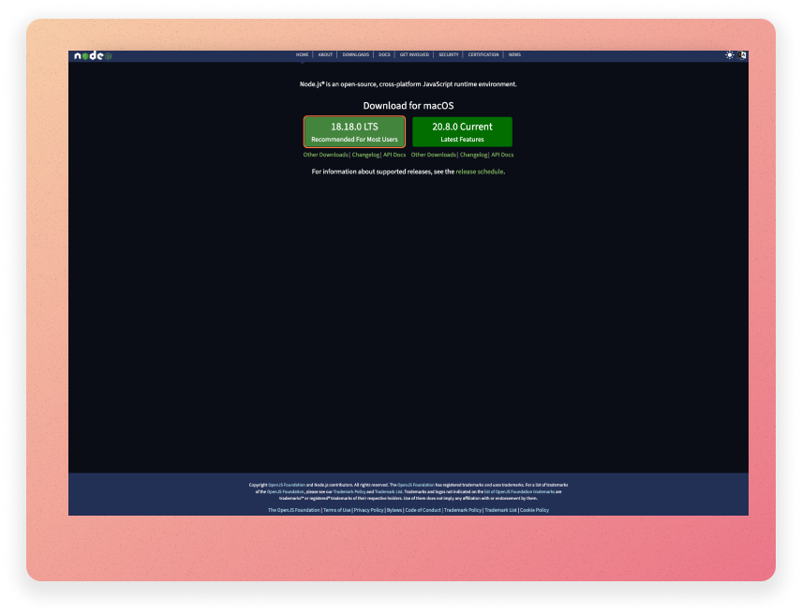
Installing Node.JS
To run JavaScript in the NodeJS environment, you should install NodeJS on your computer. Go to the official Node.js website at https://nodejs.org and download the installer

Slide 45
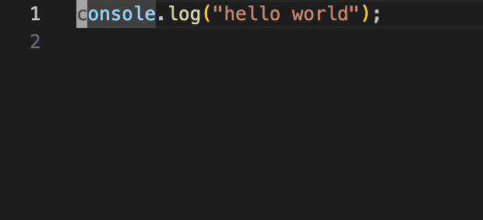

Creating Our First Node.js Program
index.js
Our terminal

Slide 46
HTML
Part I

Slide 47
HTML and CSS strategy
Assumption: Most people have cursory familiarity with HTML and CSS. Therefore we will:
  Speed through the obvious stuff
  Skip self-explanatory syntax
  Skip the parts you can look up easily through Google

Slide 48
What is a markup language?
“A text-formatting language designed to transform raw text into structured documents”
Source: American National Standard Dictionary
of Information Technology (ANSDIT)
Source code (raw text)
  <p style="color:red;">Red Text<p>
What you see in browsers (structured document)
  Red Text

Slide 49
HTML and CSS
HTML
  a markup language designed for web use
  describes the structure and content of the page
  descriptive markup
CSS
  a generalised stylesheet language
  specifies how the page should be rendered in various media (e.g. visual styles for screen display)
  procedural (presentational) markup

Slide 50
HTML editor?
HTML documents (web pages) are human readable textual files.
⇒ You don’t need any special software to create/edit HTML
documents!
⇒ Any textual editor will do the job. [I use VS Code]
  However, you may find a textual editor with HTML syntax highlighting (e.g. Notepad++) very useful.
There do exist WYSIWYG (wiz-ee-wig) HTML editors (e.g. Adobe Dreamweaver), but to learn you better work directly with raw HTML code!

Slide 51
Web server or local files?
Web pages do not have to be tested on a remote web server.
To start learning HTML, you only need a (good) textual editor and a (good) web browser on your local machine!

Slide 52
HTML tags
HTML tags = Keywords surrounded by angle brackets, e.g. <html> and <p>
HTML tags normally come with pairs, e.g. <html>
… </html> and <p> … </p>.
  In each pair of HTML tags, the first one (e.g. <html>) is called the start tag or opening tag, and the second one (e.g. </html>) is called the end tag or closing tag.
Inside the angle brackets, the ending tag starts with
a special character “/” (slash).

Slide 53
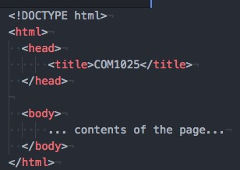


Basic HTML page structure
E.g.
<title> shows up as the name of the tab
Metadata that doesn't appear in the viewport of the browser
Contents that render in the viewport of the browser
Saved in a filename.html file

Slide 54
Encoding

Slide 55
Encodings (i.e. character sets)
Encoding is necessary so that computers understand the data we enter.
  Characters must be encoded to a numerical (binary, decimal, hex) equivalent.
Every character is “given” (i.e., encoded to) an “x-bit number”,
called code point where x depends on the encoding we use:
  e.g.: UTF-32: each character is stored in 4 bytes (=32 bits).
URL encoding converts characters into a format that can be
transmitted over the Internet.
Your browser will encode input, according to the character-set used in your page.
The default character-set in HTML5 is UTF-8 (most popular).

Slide 56
Why do they matter for web content?
Why do they matter for the Web?
  You know it matters for URLs (addresses of web pages).
  It matters for web content as well…
Web pages are textual documents.
  A textual document = A sequence of characters encoded using a specific character encoding.
⇒ A character encoding is needed for creating the content of a web page and storing the web page as a file in the web server’s file system.
To display an HTML page correctly, a web browser must know the character set used in the page.

Slide 57
Declaring character encoding
The Character set meta tag is used to specify the encoding, of data that your
HTTP server sends.
To display an HTML page correctly, a web browser must know the character set used in the page.
  This is specified in the <meta> tag:
    HTML 4.01: <meta http-equiv="Content-type" content="text/html;charset=…">
    HTML5: <meta charset=“UTF-8”>
Why do we need HTML codes?
  The browser may get the encodings wrong.
  One symbol might show up as another, or as an unknown character.
What is <meta>?
  <meta> elements declare different kinds of metadata about an HTML document.
(We will come back to it later.)
  Metadata will not be displayed on the page but will be machine parsable.
  <meta> elements should be nested in the <head> element.

Slide 58

HTML (part II)

Slide 59
HTML vs CSS
HTML:
  provides a structure that defines elements like tables, forms, lists and headings, and identifies where different portions of our content begin and end
  can be used to embed other file formats like videos, audio files, documents like PDFs and spreadsheets, among others
CSS:
  stands for cascading style sheet
  used to create rules about the colour, font, and layout of our pages
  also determines when those rules are to be used, based on information like the device connecting to the page, or in response to a user’s action

Slide 60
Page Layout
To add content to our page, we will set up our file with some basic structure
We use tags to identify information about where parts of our page start
and end
We will do this by using our first set of tags, <html> and </html>
  An HTML element is everything from a start tag to the corresponding end tag: <title>This is the title.</title>
  HTML elements are building blocks of HTML documents
  Wrapping = placing a set of tags around content and other code
The content of an HTML element is everything between the start tag and the end tag.

Slide 61

Page Layout
HTML elements can be nested:
<head><title>Title</title></head>
An element can be self-closing (img)
An element can have attributes (src="puppy.png")
Elements can contain other elements (e.g. p contains em and img)

Slide 62
Some HTML elements
(to place within <body>)
Top-level heading h1, h2, ... h6 | <h1>Headline</h1> which one is larger?
Paragraph | <p>The cat sat on the mat.</p>
Line break | First line <br/> Second line
Image | <img src="me.png" >
Link | <a href="google.com">click here!</a>
Strong (bold) | <strong>Be BOLD</strong>
Emphasis (italic) | My research field is <em>machine learning</em> and <em>computer vision</em>
Horizontal rule | My Bio: … <hr> My Publications

Slide 63
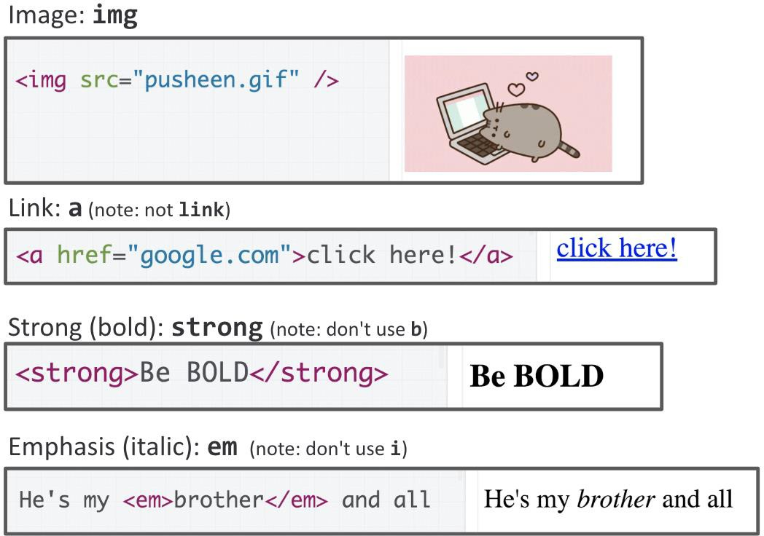
Some HTML elements

Slide 64
Types of HTML elements
Each HTML element is categorised by the HTML spec into:
  block: large blocks of content, has height and width
<p>, <h1>, <blockquote>, <ol>, <ul>, <table>
    Starting with a new line
    Take up the full width of the page (flows top to bottom)
    Have a height and width
    Can have block or inline elements as children
  inline: small amount of content
<a>, <em>, <strong>,<br>
    Starting within the current line
    Cannot have height and width
    Cannot have a block element child
    Cannot be positioned (i.e. CSS properties like float and position do not
apply to inline elements)
  inline block: inline content with height and width <img>
  metadata: information about the page, usually not visible
<title>, <meta>

Slide 65
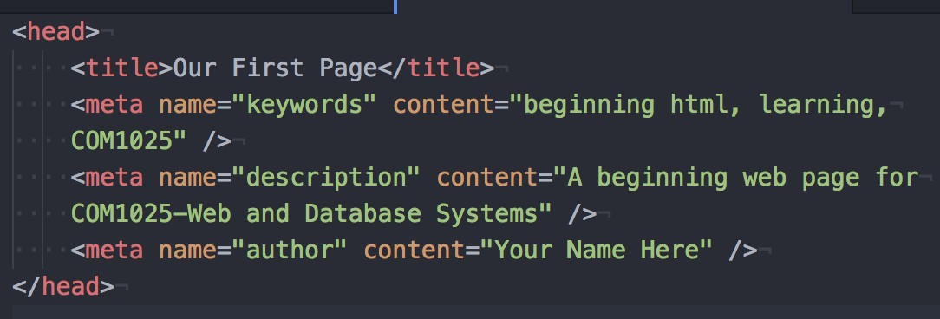
Head
This is where we:
  put information about the page itself (called metadata)
  connect to any other resources like scripts and files that are not part of the page we are using
It is important that your <head> tags are always the first set of tags after
<html>, as this is the order in which browsers expect the information
Add some meta tags inside our head to give it a title, keywords, a description, and other details
  These pieces of information help the user and bots understand what the page
is about

Slide 66
HTML attributes
Most HTML elements have compulsory and/or optional attributes
Attributes provide additional information about an HTML element
Attributes are always specified in the start tag
How an attribute is specified (name + value):
  name="value" or name='value'
  name=value is also allowed if value does not contain space or any of any
of "'`=< >
  the quotes identify what belongs to that attribute
Example
  <html lang="en"> (lang defines language used)
  <meta charset="UTF-8">

Slide 67
HTML facts
Comments in HTML
  <!-- Comments are here. -->
The file extension of an HTML document can be either “htm” or “html”
  No differences apart from the fact that some host servers expect
index.html than index.htm
HTML is case insensitive
In HTML code, more than one continuous spaces count as one space and line breaks are treated as spaces
  More than one spaces (recall &nbsp;)

Slide 68
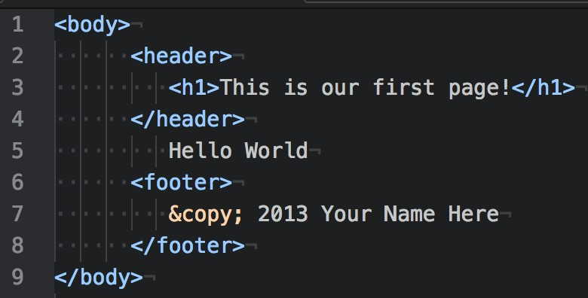
Header, Footer
The header and footer tags are new in HTML5.
They were added due to the volume of sites that define a top and bottom section to their pages.
Allowing these tags makes it easier to define and find those parts of the
layout.
The header and footer should be nested within your body tags
For our example, we will put a screen title in our header and a copyright
in our footer:

Slide 69
HTML tags: lists
ordered list
  <ol>
<li>Item 1</li>
<li>Item 2</li>
...
</ol>
  li = list item
https://www.w3schools.com/tags/tag_ol.asp

Slide 70
HTML tags: lists
unordered list
  <ul>
<li>Item 1</li>
<li>Item 2</li>
...
</ul>
https://www.w3schools.com/tags/tag_ol.asp

Slide 71
HTML tags: lists
description list
  <dl>
<dt>item1</dt>
<dd>dscrp1</dd>
<dt>item2</dt>
<dd>dscrp2</dd>
</dl>
https://www.w3schools.com/tags/tag_dl.asp

Slide 72
Tables
Tables are a method of formatting the content of your page, and are very similar to the concept of a spreadsheet
To create a table, we first need to define its beginning and end with tags:
  <table></table>
Adding row <tr>, Add table heading <th>
https://www.w3schools.com/tags/tag_table.asp

Slide 73
HTML tag: <iframe>
Basic syntax
  <iframe src="..." ...>text for web browser without iframe support</iframe>
This HTML tag allows display of another HTML document in an inline
(embedded) frame.
Some commonly used attributes
  src: URL of the embedded HTML document
  name: name of the iframe (which can be the value of target attribute of
an <a> element)
  width, height: width and height
  frameborder: size of the iframe border
https://www.w3schools.com/tags/tag_iframe.asp

Slide 74
End of Week 1

